Slide 1



PROJECT OVERVIEW
The student doubt forum web application is a platform designed to help students seek solutions to their academic queries. It provides a space for students to ask questions, share knowledge, and collaborate with their peers.
The purpose of this web application is to create a supportive & interactive community where students can find answers to their doubts, discuss topics, and enhance their learning experience.
Knowledge Sharing System
Knowledge Sharing System
Sai Rachana Afroz Niharika
22N31A05L7 22N31A05M3 22N31A05P8

Slide 2
Easy of use
PROJECT OVERVIEW
User engagement
The student doubt forum web application is a platform designed to help students seek solutions to their academic queries. It provides a space for students to ask questions, share knowledge, and collaborate with their peers.
The purpose of this web application is to create a supportive & interactive community where students can find answers to their doubts, discuss topics, and enhance their learning experience.
Knowledge Sharing System
Knowledge Sharing System
Community Building
Knowledge Sharing
Sai Rachana Afroz Niharika
22N31A05L7 22N31A05M3 22N31A05P8

Slide 3

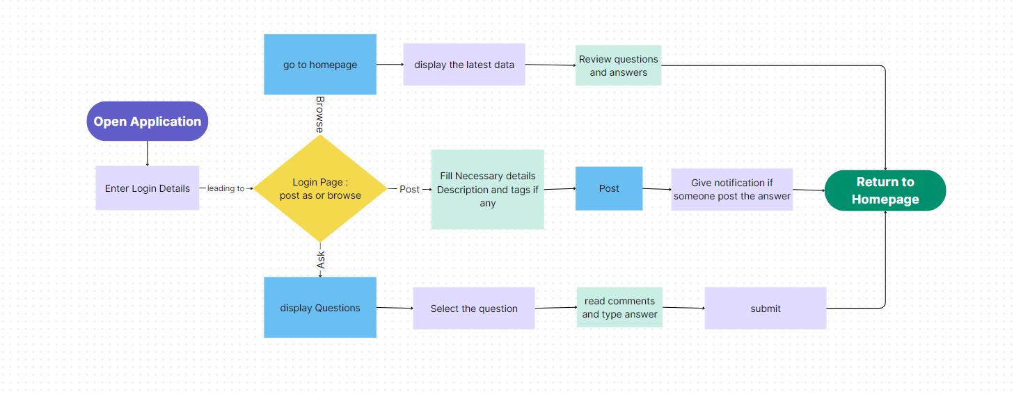

Benefits of the System
PROJECT OVERVIEW
Easy of use
User engagement
The student doubt forum web application is a platform designed to help students seek solutions to their academic queries. It provides a space for students to ask questions, share knowledge, and collaborate with their peers.
The purpose of this web application is to create a supportive & interactive community where students can find answers to their doubts, discuss topics, and enhance their learning experience.
Knowledge Sharing System
Knowledge Sharing System
THANK YOU
Community Building
Knowledge Sharing
HTML & CSS Python Tkinter
SQLite Database
Sai Rachana Afroz Niharika
22N31A05L7 22N31A05M3 22N31A05P8

Slide 4
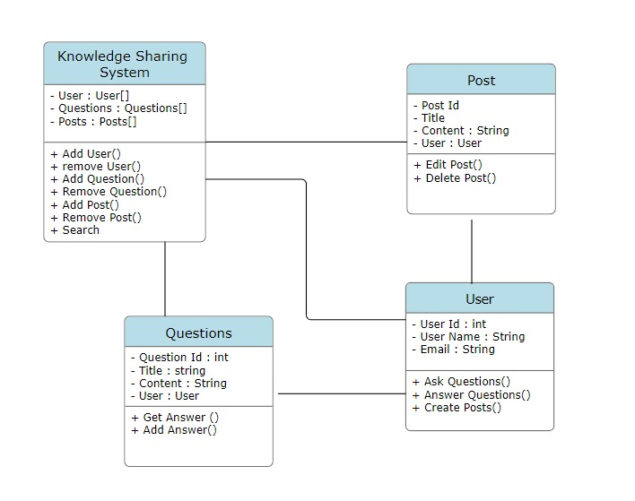
Easy of use
User engagement
Easy of use
User engagement
Knowledge Sharing System
Knowledge Sharing System
THANK YOU
Python Tkinter
Python logic processing
SQLite Database
Community Building
Community Building
Knowledge Sharing
Knowledge Sharing
Sai Rachana Afroz Niharika
22N31A05L7 22N31A05M3 22N31A05P8

Slide 5
Class Diagram
THANK YOU
HTML & CSS Python Tkinter
SQLite Database
Sai Rachana Afroz Niharika
22N31A05L7 22N31A05M3 22N31A05P8

Slide 6
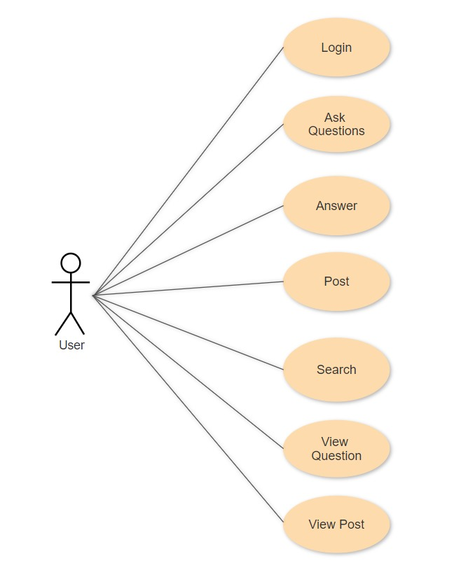
Use Case Diagram
THANK YOU
HTML & CSS Python Tkinter
SQLite Database
Sai Rachana Afroz Niharika
22N31A05L7 22N31A05M3 22N31A05P8

Slide 7
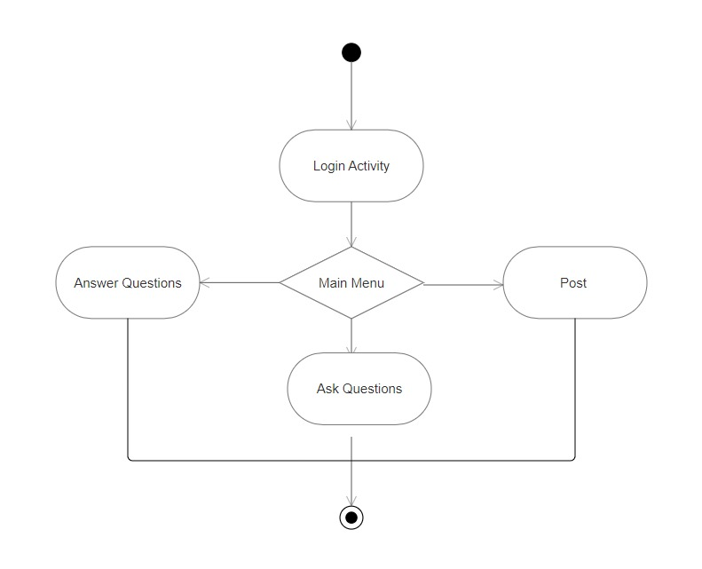
Activity diagram
HTML & CSS Python Tkinter
SQLite Database
Sai Rachana Afroz Niharika
22N31A05L7 22N31A05M3 22N31A05P8

Slide 8
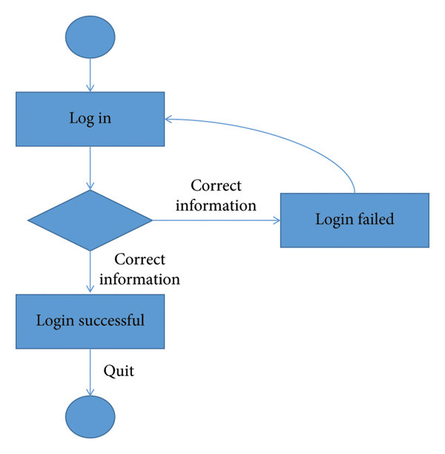
Functional Requirements
State Chart Diagram
Functional Requirements
THANK YOU
HTML & CSS Python Tkinter
SQLite Database
Sai Rachana Afroz Niharika
22N31A05L7 22N31A05M3 22N31A05P8

Slide 9
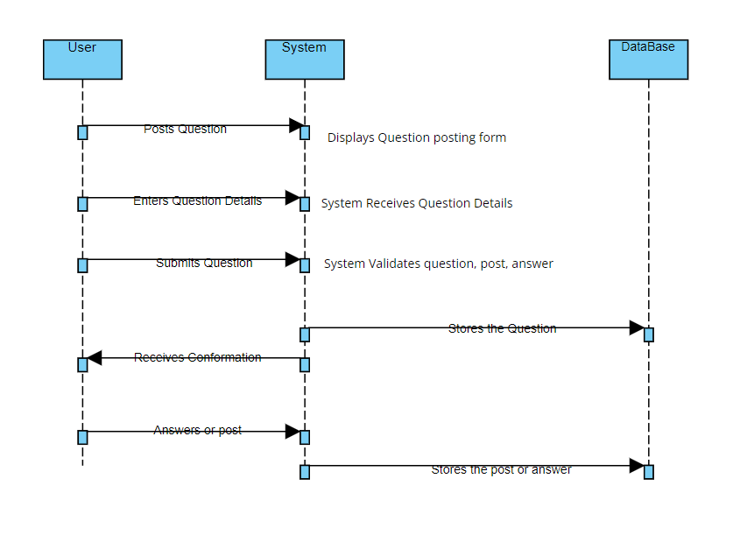
Functional Requirements
Sequential Diagram
Functional Requirements
HTML & CSS Python Tkinter
SQLite Database
Sai Rachana Afroz Niharika
22N31A05L7 22N31A05M3 22N31A05P8

Slide 10
Sequential Diagram
Functional Requirements
User Management
Question and Answer forum
Project Showcase
User Interactions
Functional Requirements
Performance
Security
Usability
Constrains
Sai Rachana Afroz Niharika
22N31A05L7 22N31A05M3 22N31A05P8

Slide 11
Functional Requirements
THANK YOU
Functional Requirements
Sai Rachana Afroz Niharika
22N31A05L7 22N31A05M3 22N31A05P8

